Slide 1

LaunchCode Liftoff
Class 3
Kevin Beashore
12/16/21

Slide 2
“No one in the brief history of computing has ever written a piece of perfect software. It's unlikely that you'll be the first.” - Andrew Hunt
Author of The Pragmatic Programmer

Slide 3
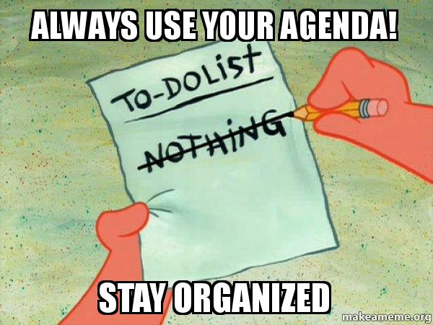
Agenda
Technical question
Objectives and Timeline
Lecture
Git Demo
Software licensing
Resume
Online profiles
Assignment: Project Planning
Questions
Activity
Resume Workshop

Slide 4
Coding challenge
https://www.coderbyte.com/editor/First%20Reverse:JavaScript
“First, solve the problem. Then, write the code.” – John Johnson

Slide 5

Objectives
Student should learn:
More about Git
What are Software Licensing
What, why, and different types
Know What Makes a Good Technical Resume
Utilize LinkedIn to Network with Other Professionals
Know How to Use Your GitHub Account to Showcase Projects

Slide 6
Liftoff Project Timeline
User Stories & Trello
Git, Licensing, & Online Profiles
Class 1
Class 3
Class 2
Class 4
Wireframes & Project Outline (MVP)
Project Review 1
Notes:
Aggressive goals so we can provide as much direction as possible
Weekly progress
Something to review by Week 4
Break week
THIS IS THE YOU ARE HERE SLIDE!

Slide 7
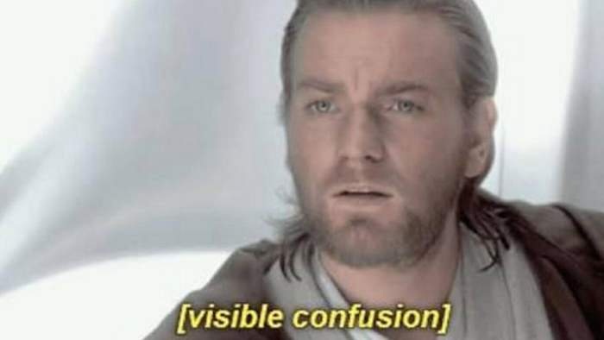



Git Demo
……….
AGAIN?!
* But better this time
Notes:
NEED TO MAKE SOME EXAMPLES FOR THIS
Should have 2 branches
Before we dive into lecture we are going to cover GIT ….. Yeah again…. Why because it part of our learning objectives ……. I promise we are going to do it better this time!
We are going to cover again a normal git workflow – branching, PR, and merging into master.
We then are going to cover a harder git workflow – with rebasing (someone asked about it so blame them you’re getting a demo!)

Slide 8
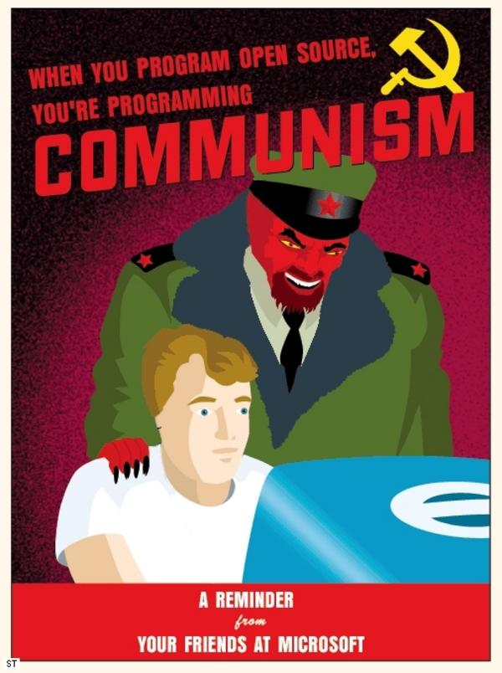
Software Licensing
Notes:
We’ll discuss what your rights are when it comes to software licensing, how to choose a license, and how to get started contributing to open source projects.

Slide 9
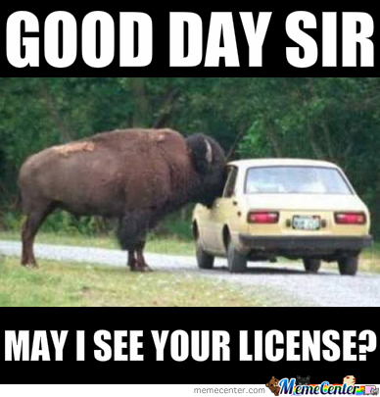
Licensing
https://choosealicense.com/
Common Questions
Should I include a license?
What license should I choose?
What If I don’t include a license?
What about code I copy/paste from Stack Overflow?
https://stackoverflow.com/help/licensing
Even loops or common patterns?
Notes:
Should I include a license?
….yeah that is why we are coving it ☺
What license should I choose….?
The TL;DR version is this go to the website……..but you are in a course to learn so we are going to the the long version……your welcome :D
What If I don’t include a license?
This means that no one can legally use, copy, distribute, or modify that software without explicit permission from the creator/author. This permission comes in the form of a license that grants the right to do so. Without that license, the baseline assumption is that you do not have permission to use the software.
What about code you copy and paste from stack overflow?
SO: Creative Commons - You really shouldn’t re-use :D https://stackoverflow.com/help/licensing
You still have exclusive copyright over GitHub code you’ve pushed

Slide 10
Software Licensing – The What
Document that provides legally binding guidance for the use and distribution of a given piece of software
Establishing the relationship between developers and end-users
Outlines: cost, level or access to source code, and amount to be downloaded
Establishing the relationship between developers and end-users
Other names “end-user agreement” or “enterprise license agreements”
Notes:
What is it? It’s a document that provides a legal guidance for the use and distribution of software this means the rights of the developer (us) and user of a piece of software(end users)
Why is it important? It give developers…… It defines how the software can be used and how it will be paid for.

Slide 11
Software Licensing – The Why
Protect developers by:
Adding copyright laws to intellectual property and trade secrets for companies
Limit what end-users can do with our software and limit our liability
Protect end-users by:
Defining what they can do with the code
Protect them from infringement claims and limit their liability
Notes:
intellectual property are creations of the mind, & trade secrets are type of intellectual property that companies use for their economic value they can be something like formulas, practices, processes, designs, instruments, patterns, or compilations of information
Limits how many downloads (for instance, license key or product key for a given software) or uses of the code.

Slide 12
Software Licensing – General Types
Free and open source software (FOSS) – Normally just called open source the code is available to anyone and can be used modified and distribute how users see fit.
I.E. Firefox, Linux, OpenJDK, Spring, Node.js
Property licenses – “closed source” users can’t access source code directly instead they use APIs to interface with them
I.E. Windows, macOS, Google Earth, Skype, webOS

Slide 13
Software Licensing – Types
Public domain – software is available freely to the public
Permissive – if you include the original copyright and license notice in any copy of the software/source
I.E. Apache & MIT licenses
Proprietary – Illegal to copy, modify, or distribute this software
Trade secrets or intellectual property would be here
Notes:
* Public domain is available to the public pretty standard. Something to understand about this is that sometimes this type of code is not as well kept as other so might come with security concerns or lesser quality
Proprietary – if you are working in the industry this is what you will see a lot of for instance you can grab all of Facebooks code or Cerner’s EHR code stuff like that.
Permissive – This type of license will establish some requirements for distribution or modification of the software. When using code from this you have to preserve license notices, copyrights, or trademarks on anything you build from this.
Apache – This permissive license contains a patent license from the contributors of the code.
MIT - Basically, you can do whatever you want as long as you include the original copyright and license notice in any copy of the software/source.

Slide 14


Software Licensing – Types Cont`d
Lesser general public license – if you link back to the source library then you are free to do whatever
I.E. GNU lesser public license (LGPL)
Copyleft – Licensed code may be distributed or modified as part of a software application or project if all code involved is distributed under the same license.
I.E. GNU public license (GPL)
Notes:
Lesser general public license - Think, “You can use me but link back to the source code if you do”.
Copyleft – basically if you use it whatever you use it with has to also be copyleft.

Slide 15
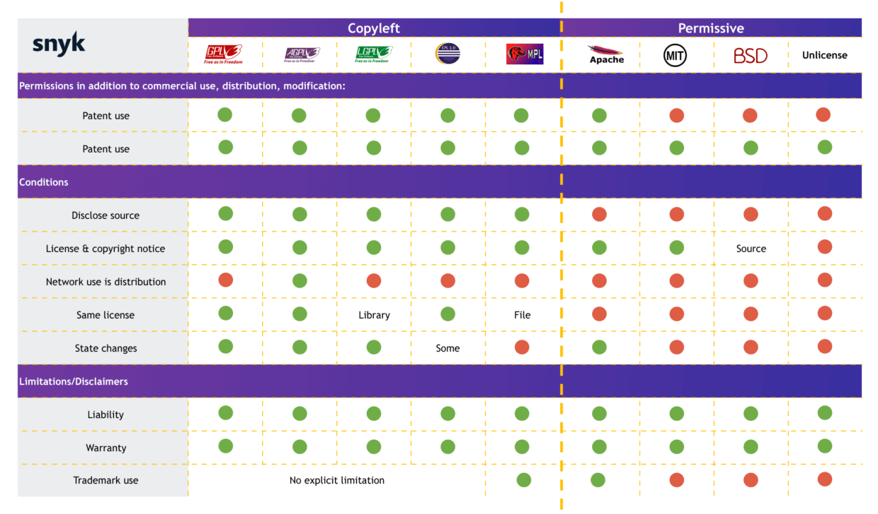
Software Licensing
Notes:
So there is a lot……..

Slide 16

Your Property Rights and You!
You Own Your Code
Sell It (Work)
Give it (Open Source)
Do Neither (Own It)
Employer IP Contract

Slide 17

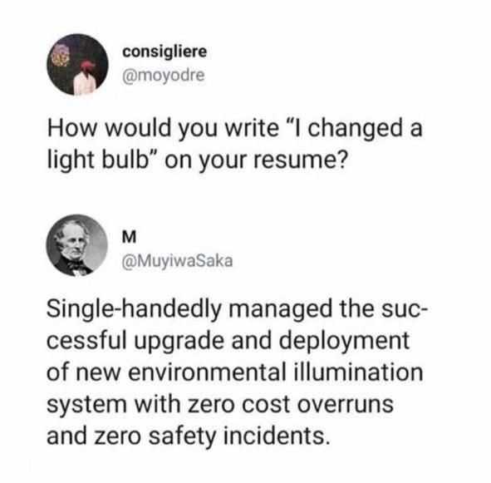

Resume
Deployed successful upgrades of illumination systems with zero cost overruns or safety incidents
Notes:
I really tried to add all the memes to try and keep everyone engaged. I know lectures can be boring so with that said hopefully you like them. I’m going to pause to grab a drink and let you enjoy for a second.
Side note: I joke a lot about this light blub meme but it actually highlights some important points like
Phrasing, providing value to what you are doing. Right the “change light blub” doesn’t tell an employer much about the outcome or the result but the ZERO COST and SAFETY section does.
That being said I would probably rewrite the bottom of the meme to something like….. Mainly because it is to wordy and kind of repeats it’s self.

Slide 18
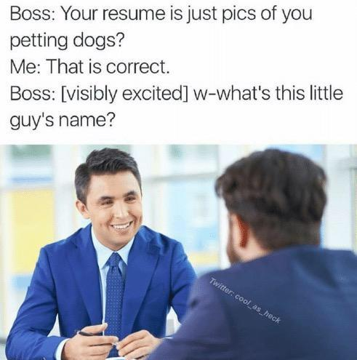
Resumes
Have an Objective
List Technical Skills
Highlight Your Strengths
Use Action Words & Concrete Results
Tailor Your Resume
KISS (Keep It Simple, Stupid)
List LaunchCode LC101 & Liftoff
Notes:
Prep Work Example https://education.launchcode.org/liftoff/articles/technical-resume/

Slide 19
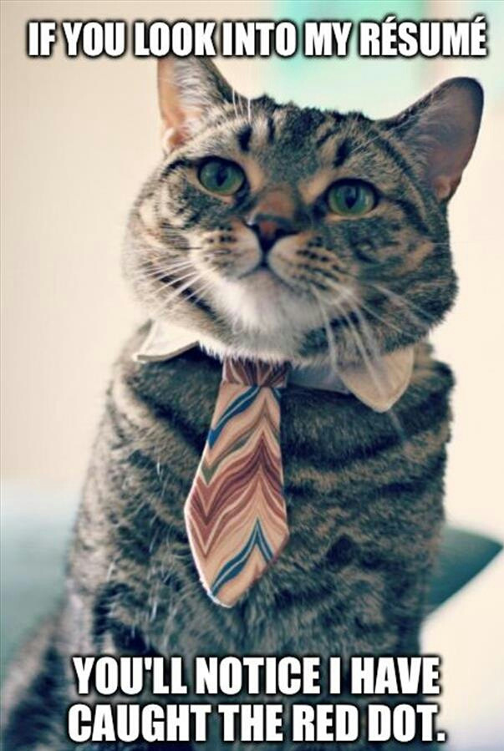
Resume
Create a rough outline
Example Headlines: Employment, Education, Languages and Technologies, & Awards etc.
Roughly fill in outline don’t care about a page limit
Lists – order in competency or your comfort level
JavaScript; Java; React; Vue (Proficient); C#; GraphQL; SQL (Past Experience); C; C++; CSS.
Formatting – grids are your friend
Consistency
Notes:
Think of how your read will see your resume! Where are they going to look first? – we are going to come back to this thought later…
When creating a rough draft don’t worry about a page limit just get all the information you have in your head out there. You can come back later and edit your thoughts to spice it up and make it better later. **WISPHER** -- most of the time you will have over lap
Lists should be in order of preference/competency of your personal self

Slide 20
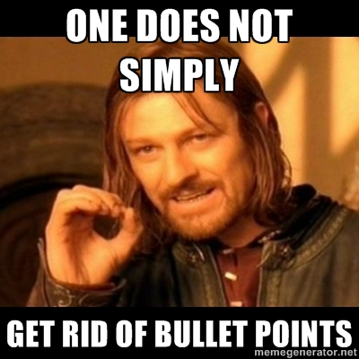
Resume Continued – Bullet points
Bullet points be informative (think “light blub”)
Corrected insurance policies.
Corrected insurance policies by improving databases.
Corrected 10+ farmers’ insurance policies totaling $1,000,000+ by improving databases with C# and SQL.
Quantitative over Qualitative
Formulas are your friend:
"Accomplished [X] as measured by [Y], by doing [Z].”
-ed verb + outcome/metric + by/through/using + how I did it.
Notes:
Think of how your read will see your resume! – we will come back to this thought
Bullet points should strive to be informative remember the light blub meme
1 & 2 & 3 Here we have an example is 1, 2, 3 better. Type in chat unmute whatever but provide your opinion ready….go
Normally, Qualitative data is better than Qualitative….number, hard evidence, things that can tell the ”why what you did is important”
Using a formula might help, google recruitors say X-Y-Z formula is great! https://www.inc.com/bill-murphy-jr/google-recruiters-say-these-5-resume-tips-including-x-y-z-formula-will-improve-your-odds-of-getting-hired-at-google.html#:~:text=Google%20describes%20this%20as%3A%20%22Accomplished,you%20had%20as%20a%20result.
Another formulas like it is below “past tense action verb” + outcome + then connect it together by how you did it

Slide 21
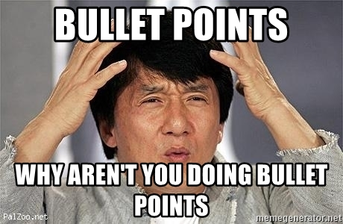
Resume Continued – Bullet points Examples
Pick one:
Communicated with families to convey the benefits of our program leading to 75% enrollment increase.
Increased enrollment 75% through improved communication to help families understand the importance of low-turnover, high-quality care.
Pick one:
Managed relationships with Michael’s, Walmart, and Amazon which had sales of $10 million.
Added $10 million in sales by managing relationships with Walmart and Amazon.
Notes:
Think of how your read will see your resume! – we will come back to this thought
Bullet points should strive to be informative remember the light blub meme
1 & 2Here we have an example is 1 or 2 better. Type in chat unmute whatever but provide your opinion ready….go
Using a formula might help, google recruitors say X-Y-Z formula is great! https://www.inc.com/bill-murphy-jr/google-recruiters-say-these-5-resume-tips-including-x-y-z-formula-will-improve-your-odds-of-getting-hired-at-google.html#:~:text=Google%20describes%20this%20as%3A%20%22Accomplished,you%20had%20as%20a%20result.
Normally, Qualitative data is better than Qualitative….number, hard evidence, things that can tell the ”why what you did is important”

Slide 22
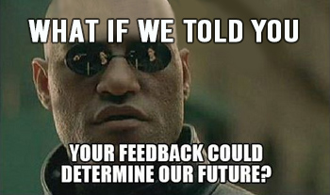
Resume Continued - Feedback
Online Grammar checkers!! (https://www.grammarcheck.net/editor/)
Peers – help each other out!
Mentor Feedback
Ping John or I
Notes:
Grammer checkers they don’t catch everything but they help a lot! The one I linked help me throughout school and it is the first result if you google grammar checkers. I personally use, Grammerly in my day to day (web browser extension) that helps me a lot. Google them you will find more
Peers – Help each other out! When you get into the industry you are not going to be working in silos…..so don’t work in silos here. NOTE: sometimes you will work in silos in the industry but it’s because you need to really learn something before bring it back to the team.
Mentors that is what they are here for most of them went through this or have jobs in tech trust them they know what they are doing.
John or myself – if you want feedback John and I will be happy to help out

Slide 23
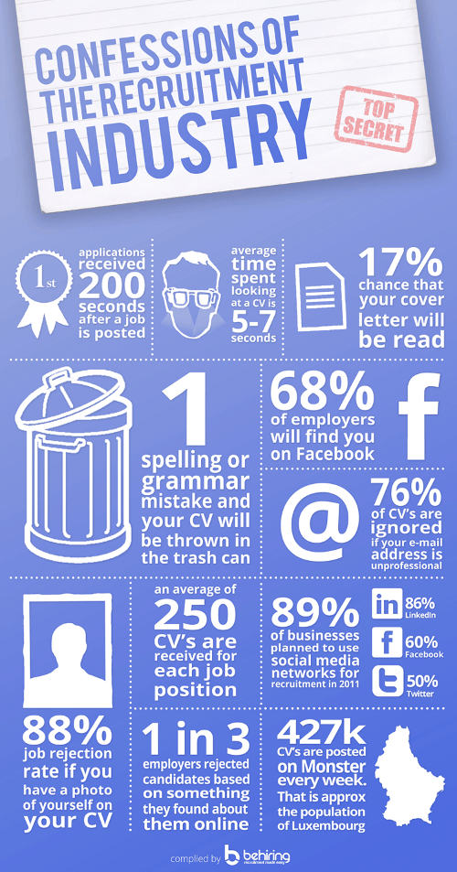
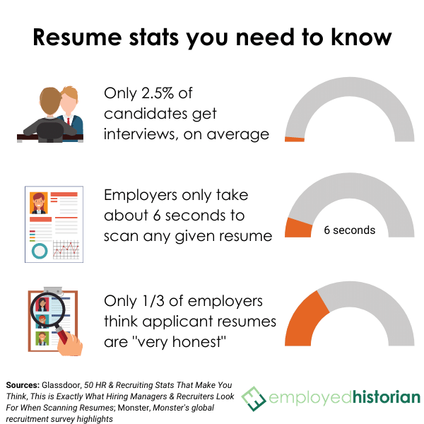
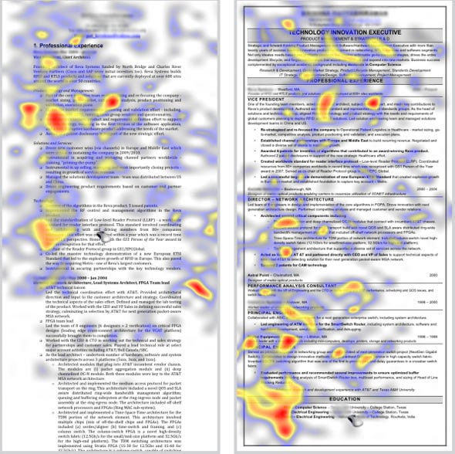
Resume Stats
Notes:
What do you think the average time a recruiter spends on a resume? …..5-10 seconds. Don’t freak out, Hiring managers and other interviewers, will spend more time looking at it to prepare questions I’m sure. The 5-10 seconds a recruiter sees the resume is important but they will get more information for a phone call with you than they will your resume. They are simply using that time to weed out things that their computer system might not have.
These
Going back to thinking of how your read will see your resume! – the photo in the middle is a heat map of readers scan your resume. Think about what you want their eyes attracted to.

Slide 24
Online profiles
Notes:
Advocate for personal branding
Build networks, know what’s hot, get new jobs, never settle

Slide 25
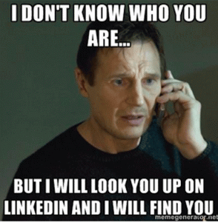
LinkedIn
Summary - Tell a Story!
Projects - Highlight Features
Previous Employment
Education - LaunchCode \o/
Skills
Volunteering
Accomplishments

Slide 26

GitHub Profile
Professional Name and Picture
Star Your Best Projects
Follow each other
Notes:
Kind of you programming portfolio until you get more time in the industry since you will be doing a lot of work on your companies specific intranet.

Slide 27
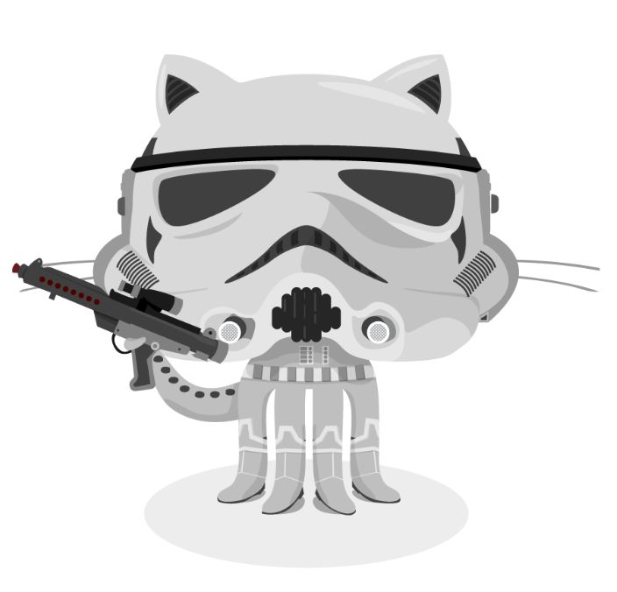
GitHub Projects
Clear Names
Self-Contained
Clean Up Cruft
Common Files to Include:
README.md
Create a README
Mastering GitHub Markdown
License.txt
.gitignore

Slide 28
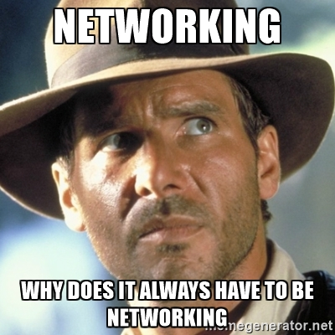
Online Communities
LaunchCode Community & Alumni
Twitter
Facebook groups
Slack / Discord
Meetup: https://www.meetup.com/
Hacker News: https://news.ycombinator.com/
Menteaship www.menteaship.com
Share Your Favorites in #general
Notes:
How do I keep up (know what to know)?
Networking!? Business cards!
Make connections, ask questions, find what excites you, it’s a big world

Slide 29
Project Planning

Slide 30
Assignment: Project Planning
A wireframe for each page in the MVP of your project, at least 3 total.
A link to your public project tracker (i.e. Trello).
If you have not already, create your initial project repository in GitHub
Notes:
hand-drawn wireframes that you have photographed using your smartphone or they can be PDF or image exports. Add them in your README or add them in another markdown file, something like, wireframe.md and link it to your main readme

Slide 31
“If I cannot do great things, I can do small things in a great way.” - Martin Luther King
Notes:
I recently went to the nation civil rights museum in Memphis and heard this quote. I really liked it so here you go. We all might not be doing great things yet but the things we can do we can do to the best of our ability to make sure they are great!
And with that – any questions

Slide 32

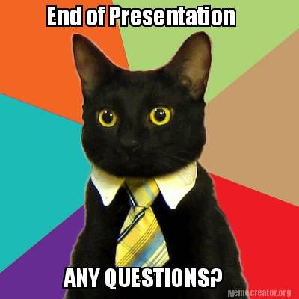
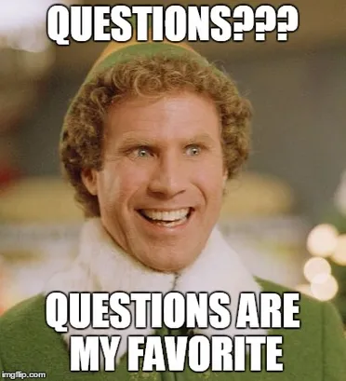
QuEsTiOnS
??????
QuEsTiOnS

